Slide 1


Review of L8-L14
INT301 Bio-computation, Week 14, 2024
Notes:
Images should be RGB colour setting
Header: Uppercase, Calibri size 28, XJTLU Navy
Body Text: Sentence case, Calibri size 14, Black

Slide 2
Review
L8: Radial-Basis Function(RBF) Network
L9-10:Time-series Prediction, Elman Network, Recurrent Network
L11-L12: PCA and Unsupervised learning
L13: Self-organizing Feature Map
L14: Associative Memories & Hopfield network

Slide 3
Review:Radial-Basis Function(RBF) Network
RBF network can be viewed as a curve-fitting or function approximation problem.
For the problem of curve-fitting (approximation in high-dimensional spaces), learning is equivalent to finding an interpolating surface in the space that provides a best fit to the training data, measured by preselected statistical criteria.

Slide 4
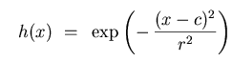
Review:Radial-Basis Function(RBF) Network
A Gaussian RBF monotonically
decreases with distance from the center. Gaussian-­like RBFs are local (give a significant response only in a neighborhood near the center) and are more commonly used.
They are also more biologically plausible because their response is finite.
c = 0 and radius r = 1

Slide 5
Review:Radial-Basis Function(RBF) Network
The important characteristic:
it is a universal approximator in that it can approximate arbitrarily well any multivariate continuous function on a compact set, given a sufficiently large number of units.

Slide 6
Review:Radial-Basis Function(RBF) Network
_{ϕ}
₍
_{X}
₎
_{X}
₁
_{w}
₁
_{x1}
_{ϕ}
_{M}
₂
₍
_{X}
₎
_{y}
₌
∑
_{w}
_{ϕ}
₍
_{X}
₎
_{w}
₂
_{i}
_{i}
_{x2}
_{i}
₌
₁
Output
_{w}
₃
∑
y
_{x3}
_{ϕ}
₍
_{X}
₎
₃
...
_{w}
_{m}
₁
_{x}
...
_{N}
_{ϕ}
₍
_{X}
₎
_{M}
_{Increased dimension:}
_{N->M}
_{ϕ}
₍
_{X}
₎
:
_{Nonlinear function}
Hidden layer: applies a non-linear transformation from the input space to the hidden space.
Output layer: applies a linear transformation from the hidden space to the output space.
_{i}

Slide 7
Review:Radial-Basis Function(RBF) Network
Φ is the NxM design matrix of basis functions

Slide 8
Review:Radial-Basis Function(RBF) Network
The unknown weights can be found by solving the following linear matrix equation using pseudo-inverse:
where: W is the weight vector, d is the response vector, and is the design matrix

Slide 9
Review:Elman Network
In statistics and machine learning, a time-series is often described by a sequence of vectors (or scalars) which depend on time t:
It’s the output of some process P that we are
interested in:
P
Observed time-series
Unknown dynamics (process)

Slide 10
Review:Elman Network
Sometimes, we require our model to be sensitive to inputs that were presented some time ago.
In other words, our requirement is not met by a function (no matter how complex it may be) and demands a model which maintains a state, or memory, over several presentations.
Which applications need memory?
sequential input (e.g. language understanding, robot exploration, ...),
sequential output (e.g. speech, route planning, ...), or combinations of the above.

Slide 11
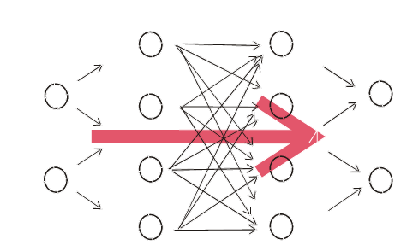
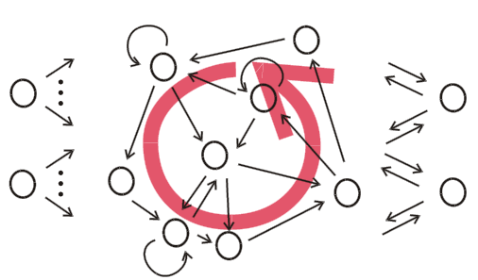
Review:Elman Network
Connections only "from left to right", no connection cycle
Activation is fed forward from input to output through "hidden layers"
No memory
At least one connection cycle
Activation can "reverberate", persist even with no input
System with memory
Mathematically, RNNs implement dynamical systems.

Slide 12
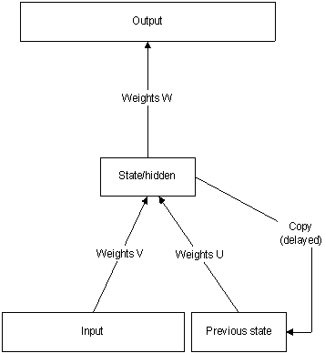
Review:Elman Network
Elman network which typically distinguishes between a state-output function and an input-state mapping.
where y is the output, x is the
input and z is the state. t is an
index in time.

Slide 13
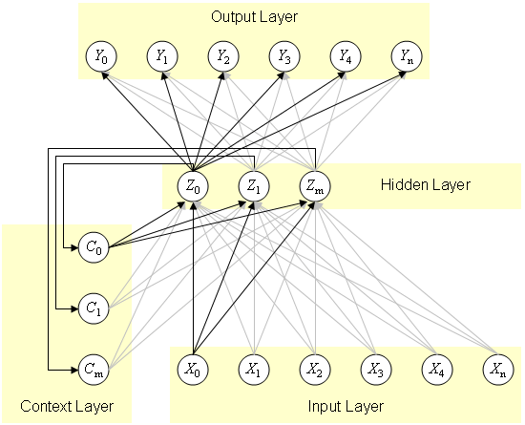
Review:Elman Network
Four layers of Elman network
Input layer
Hidden layer forming internal representation
Context layer
The value of the context neuron is used as an extra input signal for all the neurons in the hidden layer one time step later. In an Elman network, the weights from the hidden layer to the context layer are set to one and are fixed because the values of the context neurons have to be copied exactly
Output layer linear combination

Slide 14
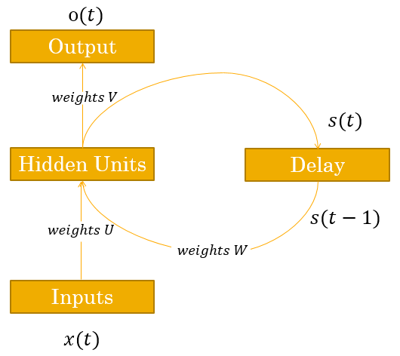
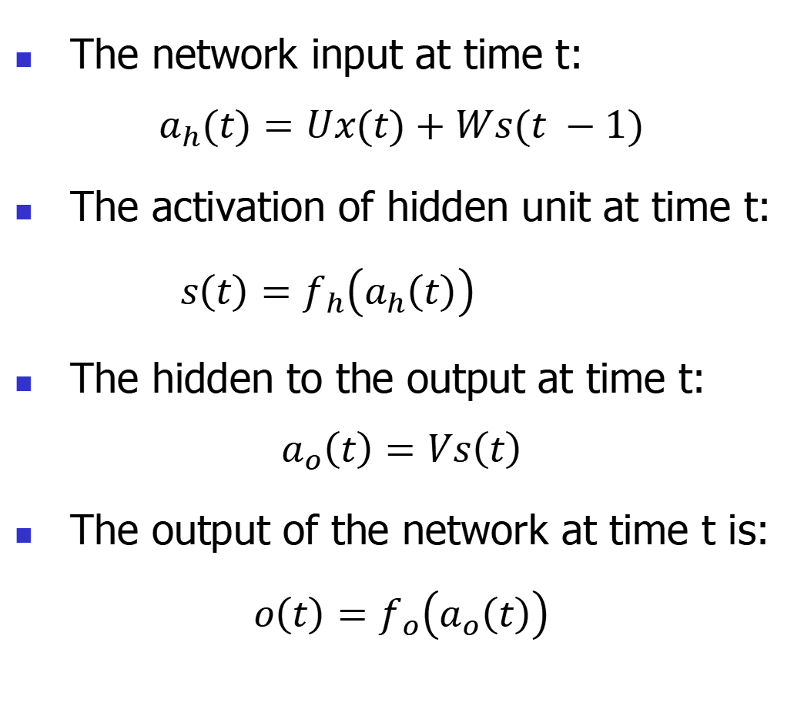
Review:Recurrent Neuron Network
The network input at time t:
$$a_{h}(t)=Ux(t)+Ws(t −1)$$
The activation of hidden unit at time t:
$s\left(t\right)=f_{h}\left(a_{h}\left(t\right)\right)$
The hidden to the output at time t:
$$a_{o}\left(t\right)=Vs\left(t\right)$$
The output of the network at time t is:
$$o\left(t\right)=f_{o}\left(a_{o}\left(t\right)\right)$$

Slide 15

Review:Recurrent Neuron Network
In RNN errors can be propagated more than 2 layers in order to capture longer history information.
This process is usually called unfolding.
In an unfolded RNN, recurrent weight is duplicated for arbitrary number of time steps

Slide 16
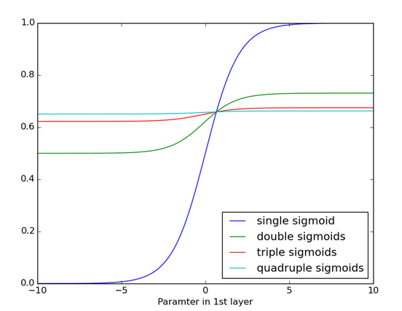
Review:Recurrent Neuron Network
RNNs trained with BPTT have difficulties learning long-term dependencies (e.g. dependencies between steps that are far apart) due to what is called the vanishing gradients problem.
The figure shows the effects of applying a sigmoid function over and over again. The data is flattened until, for large stretches, it has no detectable slope.
Vanishing gradients can become too small for computers to work with or for networks to learn.

Slide 17
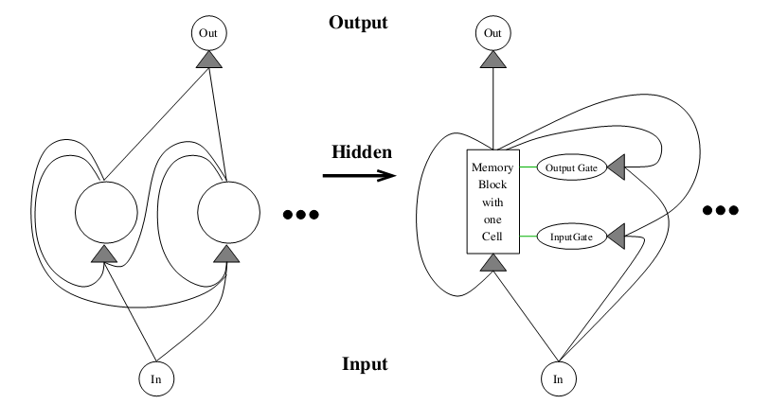
Review:Recurrent Neuron Network
The basic unit in the hidden layer of an LSTM network is a memory block, it replaces the hidden unit in a traditional RNN.
A memory block contains one or more memory cell and a pair of adaptive multiplicative gating units which gates input and output to all cells in the block.
Memory blocks allow cells to share the same gates thus reducing the number of parameters.
RNN with one FC hidden layer
LSTM network with memory blocks in hidden layer
(only one is shown)

Slide 18
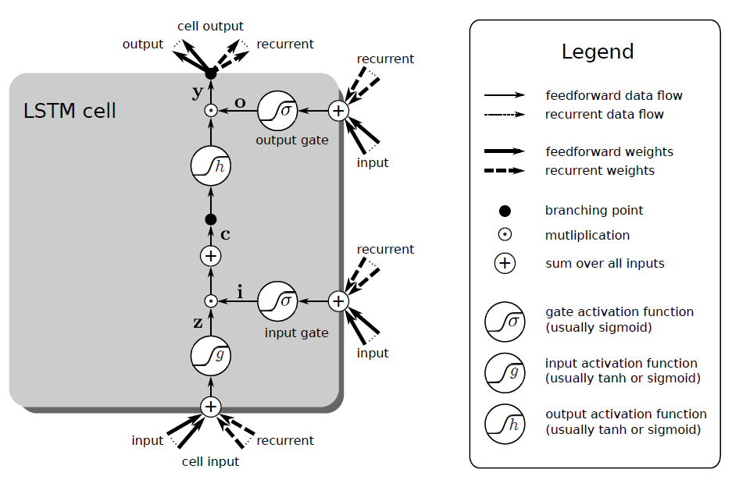

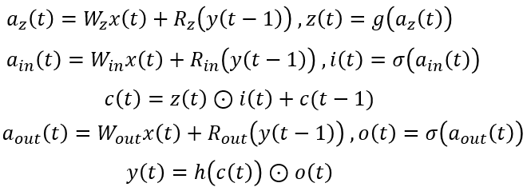
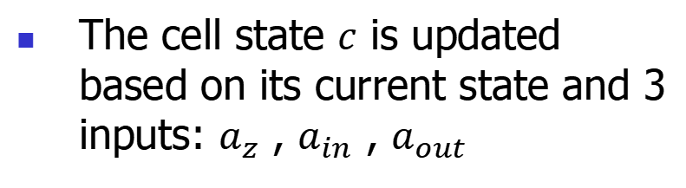
Review:Recurrent Neuron Network
The cell state $c$ is updated based on its current state and 3 inputs: $a_{z}$ , $a_{in}$ , $a_{out}$

Slide 19
Review:PCA
d
d

Slide 20
Review:PCA
d
d
d
d
d
d
Projection on the eigenvectors
Scaling with eigenvalues
Vector addition

Slide 21
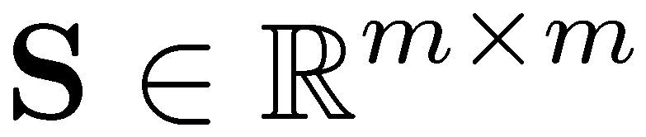
Review:PCA
Theorem: If is a symmetric matrix, there exists an eigen decomposition, where Q is orthogonal:
Q⁻¹= Q^{T}
Columns of Q are normalized eigenvectors
Columns are orthogonal.
(everything is real)

Slide 22
Review:PCA
For an m× n matrix A of rank r, there exists a factorization (Singular Value Decomposition = SVD) as follows:
m×m
m×n, nonnegative real
n×n
The columns of U are orthogonal eigenvectors of AA^{T}.
The columns of V are orthogonal eigenvectors of A^{T}A.
Eigenvalues λ₁ … λ_{r} of AA^{T} are the eigenvalues of A^{T}A.
Singular values.

Slide 23
Review:PCA
Each dimensionality reduction technique finds an appropriate transformation by satisfying certain criteria (e.g., information loss, data discrimination, etc.)
The goal of PCA is to reduce the dimensionality of the data while retaining as much as possible of the variation present in the dataset.

Slide 24
Review:PCA
x_{i2}
y_{i,1}
y_{i,2}
x_{i1}

Slide 25
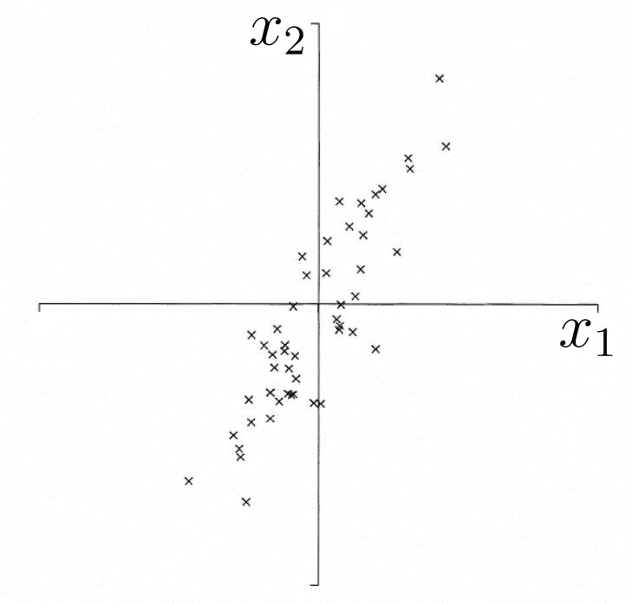
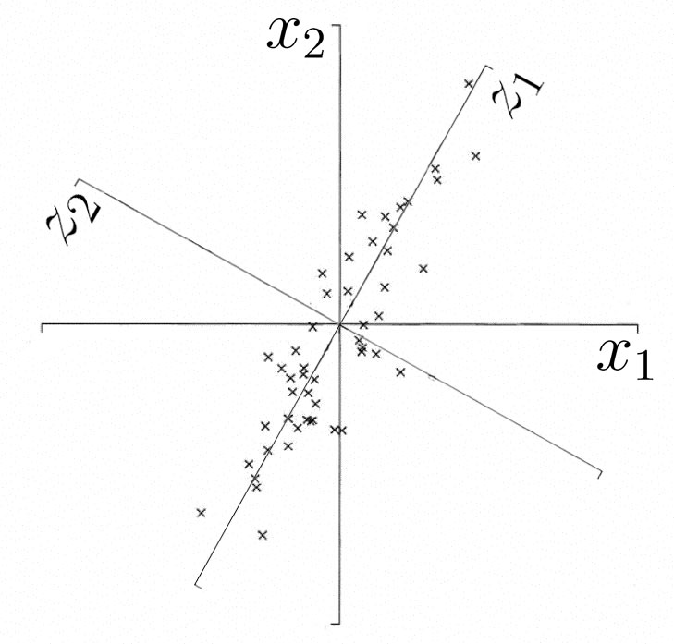
Review:PCA
Motivation
Find bases which has high variance in data
Encode data with small number of bases with low MSE
First PC is direction of maximum variance
Subsequent PCs are orthogonal to 1st PC and describe maximum residual variance

Slide 26
Review:Unsupervised Learning
A simple principle was proposed by Hebb in 1949 in the context of biological neurons
Hebbian principle
When a neuron repeatedly excites another neuron, then the threshold of the latter neuron is decreased, or the synaptic weight between the neurons is increased, in effect increasing the likelihood of the second neuron to excite
Hebbian learning rule Δw_{ji} = ηy_{j}x_{i}
There is no desired or target signal required in the Hebb rule, hence it is unsupervised learning

Slide 27
Review:Unsupervised Learning
Consider the update of a single weight w (x and y are the pre- and post-synaptic activities)
w(n + 1) = w(n) + ηx(n)y(n)
For a linear activation function
w(n + 1) = w(n)[1 + ηx(n)x^{T}(n) ]
Weights increase without bounds. If initial weight is negative, then it will increase in the negative. If it is positive, then it will increase in the positive range
Hebbian learning is intrinsically unstable, unlike error-correction learning with BP algorithm

Slide 28
Review:Unsupervised Learning
The simple Hebbian rule causes the weights to increase (or decrease) without bounds
The weights need to be normalized to one as
Oja proves that, for small η<<1, the above normalization can be approximated as:
This is Oja’s rule, or the normalized Hebbian rule
It involves a ‘forgetting term’ that prevents the weights from growing without bounds

Slide 29
Review:Unsupervised Learning
Multi-layer networks with bottleneck layer
Train using auto-associative output: e = x – y
W_{L} spans the subspace of the first m principal eigenvectors.
x₁
W_{L}
W_{R}
y₁
x₂
y₂
x₃
y₃
x_{n}
y_{n}

Slide 30
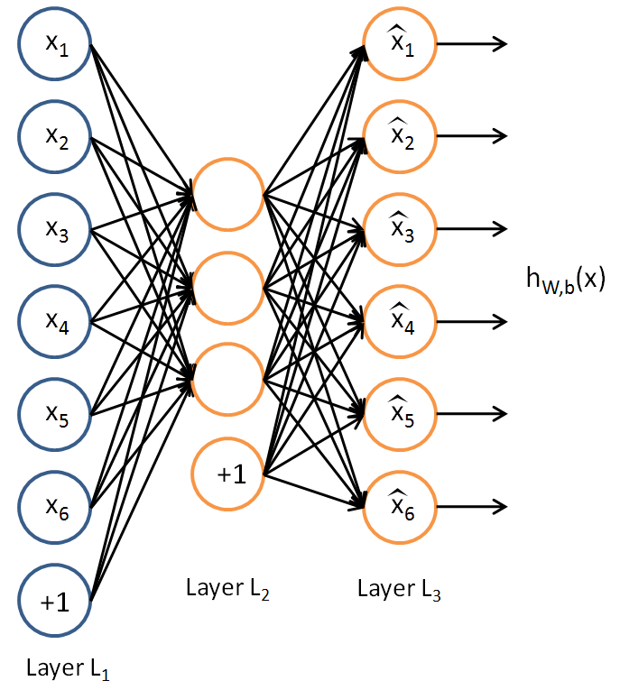
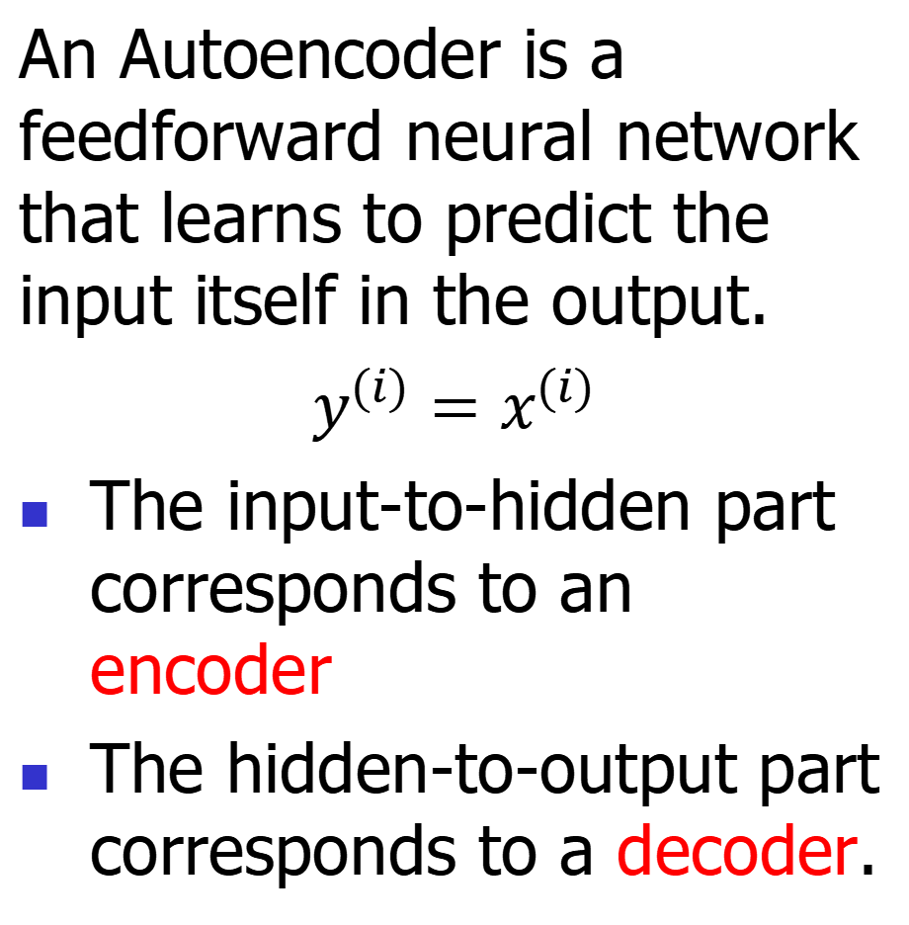
Review:Unsupervised Learning
An Autoencoder is a feedforward neural network that learns to predict the input itself in the output.
$y^{(i)}=x^{(i)}$
The input-to-hidden part corresponds to an encoder
The hidden-to-output part corresponds to a decoder.

Slide 31
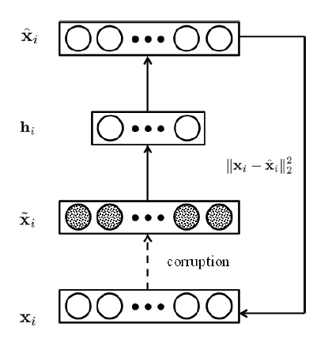
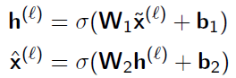
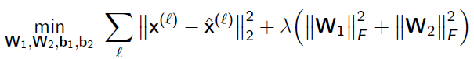
Review:Unsupervised Learning
By adding stochastic noise, it can force auto-encoder to learn more robust features.
The loss function

Slide 32
Review: K-means clustering
Choose the number of clusters - K
Randomly choose initial positions of K centroids
Assign each of the points to the “nearest centroid” (depends on distance measure)
Re-compute centroid positions
If solution converges → Stop!

Slide 33
Review:K-means clustering
A good clustering method will produce high quality clusters with
high intra-class similarity
similar to one another within the same cluster
low inter-class similarity
dissimilar to the objects in other clusters
The quality of a clustering method is also measured by its ability to discover some or all of the hidden patterns

Slide 34
Review:K-means clustering
Distances are normally used to measure the similarity or dissimilarity between two data objects
Minkowski distance:
where i = (x_{i1}, x_{i2}, …, x_{ip}) and j = (x_{j1}, x_{j2}, …, x_{jp}) are
two p-dimensional data objects, q is a positive integer
If q = 1, d is Manhattan distance
If q = 2, d is Euclidean distance:

Slide 35
Review:Unsupervised Learning
Competitive learning means that only a single neuron from each group fires at each time step
Output units compete with one another.
These are winner-takes-all (WTA) units
Competition is important for neural networks
Competition between neurons has been observed in biological nerve systems
Competition is important in solving many problems

Slide 36
Review:Unsupervised Learning
Note: the inner product of two normal vectors is related to the cosine of the angle between them
Winner:
Winner = output node whose incoming weights are the shortest Euclidean distance from the input vector

Slide 37
Review:Unsupervised Learning
(One possible) update rule for all neurons:
The neuron with largest activation is then adapted
to be more likely the input
that caused the excitation
Only the incoming weights of the winner node are modified.
Some units may never or rarely become a winner, and so weight vector may not be updated→DEAD UNIT

Slide 38
Review:Unsupervised Learning
• initialize K prototype vectors
• present a single example
• identify the closest prototype,
i.e., the so-called winner
• move the winner even
closer towards the example
Intuitively clear, plausible procedure
places prototypes in areas with high density of data
identifies the most relevant combinations of features
38

Slide 39
Review:Unsupervised Learning
Lateral inhibition
output of each node feeds to others through inhibitory connections (with negative weights)
x_{i}
x_{j}
1
2
3
A specific competitive net that performs Winner Take All (WTA) competition is the Maxnet

Slide 40
Review: Self-organizing Feature Map
Biologically motivated: how can activity-based learning using highly interconnected circuits lead to orderly mapping of visual stimulus space onto cortical surface?
2 layer network each cortical unit fully connect to visual space via Hebbian units
Interconnections of cortical units described by ‘Mexican-hat’ function: short-range excitation and long-range inhibition
cortical units
visual space

Slide 41
Review:Self-organizing Feature Map
Activity-based self-organization (von der Malsburg): after learning, a topographic map appears. However, input dimension is the same as output dimension
Kohonen simplified this model and called it Kohonen’s self-organizing map (SOM) algorithm
more general as it can perform dimensionality reduction
SOM can be viewed as a vector quantization type algorithm

Slide 42
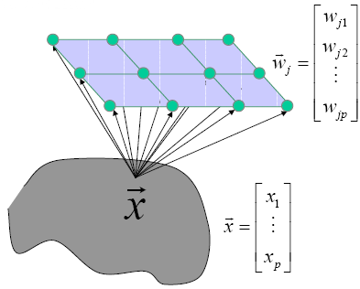
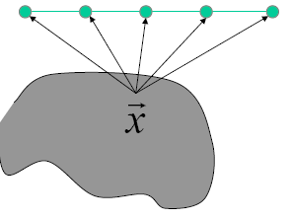
Review:Self-organizing Feature Map
The idea in an SOM is to transform an input of arbitrary dimension into a 1 or 2 dimensional discrete map
Two possible architectures

Slide 43
Review:Self-organizing Feature Map
Once weights of net initialized, algorithm comprises 3 processes:
1. Competition
Given an input pattern, outputs compete to see who is winner based on a discriminant function (e.g. similarity of input vector and weight vector)
2. Cooperation
Winning neuron determines spatial location of a topological neighborhood within which output neurons excited
3. Synaptic Adaptation
Excite neurons adapt weights so that value of discriminant function increases (a similar input would result in enhanced response from winner)

Slide 44
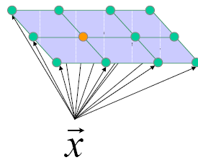
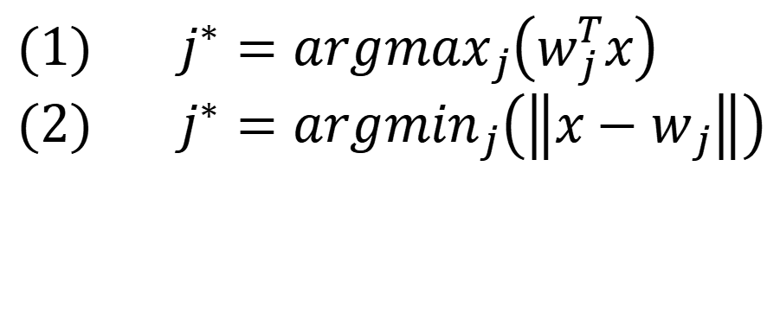
Review:Self-organizing Feature Map
Winner neuron
(1) $j^{∗}={argmax}_{j}\left(w_{j}^{T}x\right)$
(2) $j^{∗}={argmin}_{j}\left(\left\|x−w_{j}\right\|\right)$
A continuous input space of activation patterns is mapped onto a discrete output space of neurons by a process of competition among the neurons in the network.

Slide 45
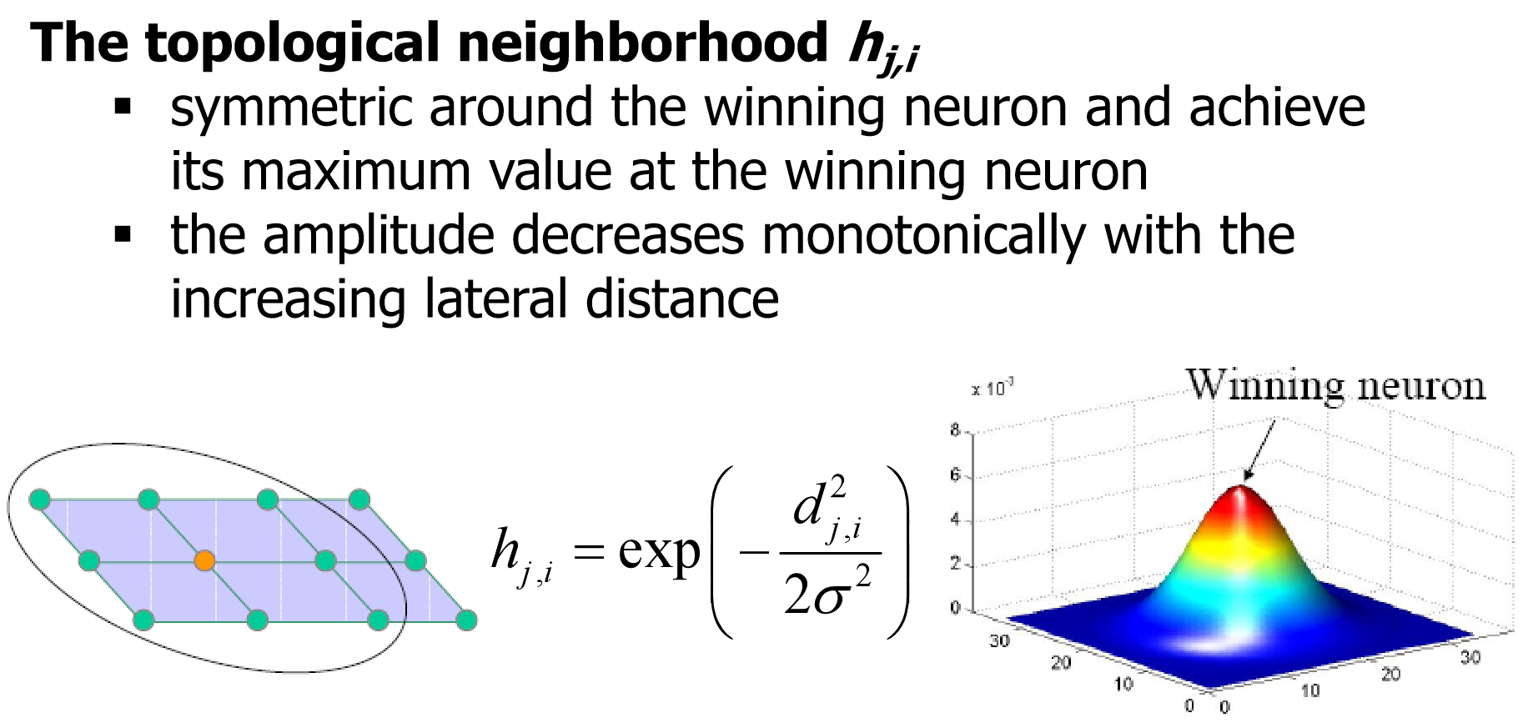
Review:Self-organizing Feature Map

Slide 46
Review:Self-organizing Feature Map
The topological neighborhood h_{j,i} shrinks with time
Neighbors of the winning node are also allowed to update, even if they are not close to winning!

Slide 47
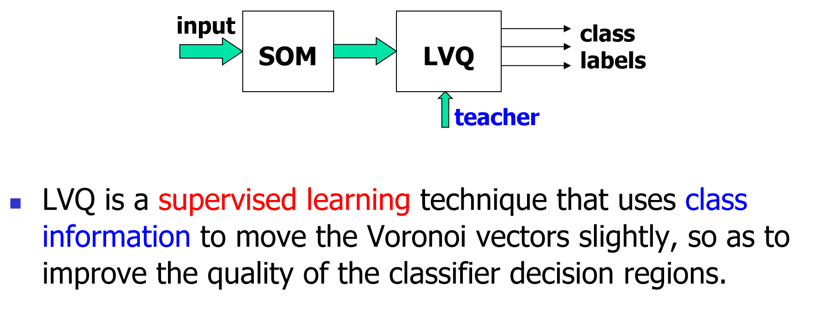
Review:Self-organizing Feature Map

Slide 48





Review:Hopfield network
_{Auto-association}
_{memory}
_{Hetero-association}
_{memory}
Former
US President
_{memory}

Slide 49
Review:Hopfield network
Similar to Hebbian learning for classification
Algorithm: (bipolar or binary patterns)
For each training samples s :t
increases if both input and output are ON (binary) or have the same sign (bipolar)
If initially, then after updates for all P training patterns
Instead of obtaining W by iterative updates, it can be computed from the training set by calculating the outer product of s and t.

Slide 50
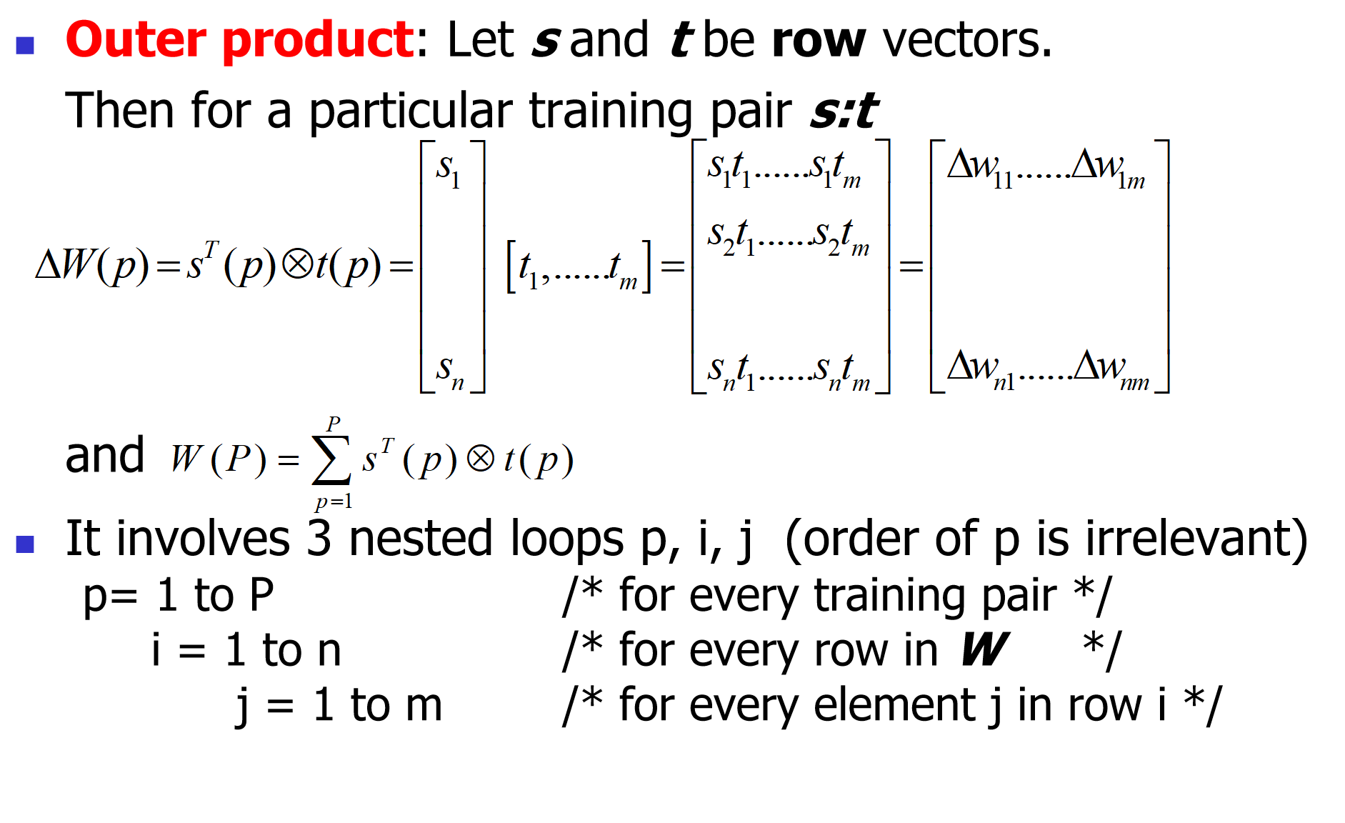
Review:Hopfield network

Slide 51
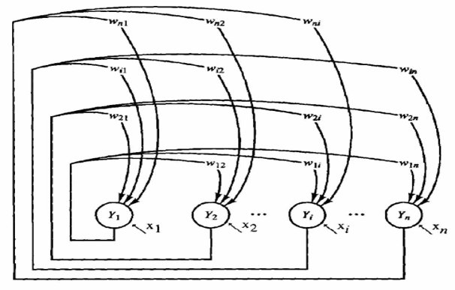
Review:Hopfield network
Architecture:
single layer (units serve as both input and output)
nodes are threshold units (binary or bipolar)
weights: fully connected, symmetric, and zero diagonal
are external
inputs, which
may be transient
or permanent

Slide 52
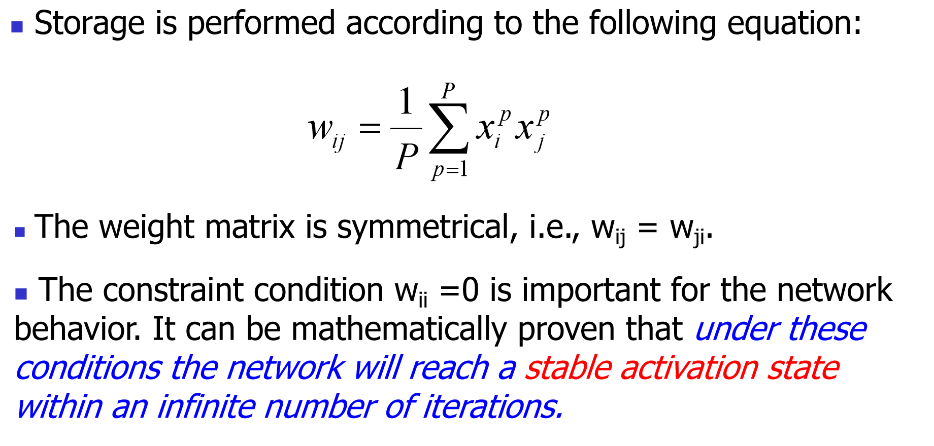
Review:Hopfield network

Slide 53
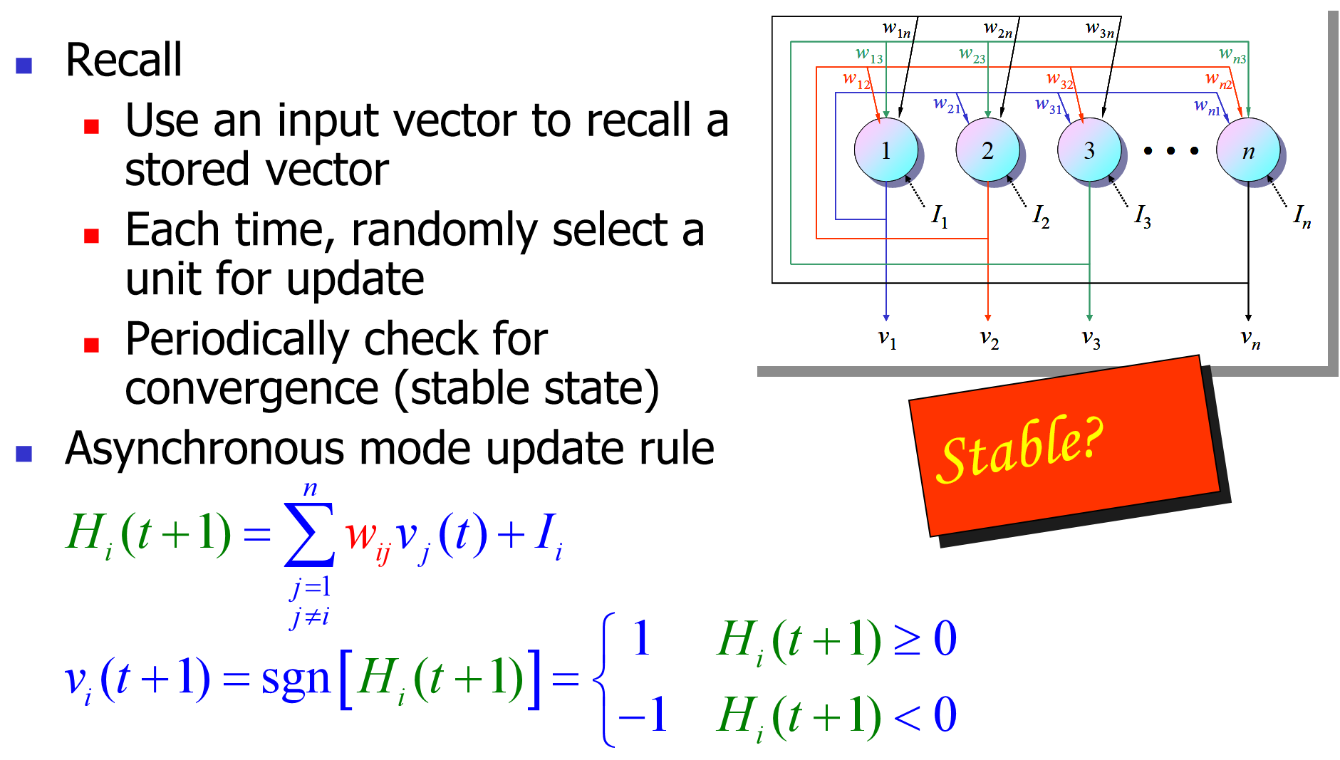
Review:Hopfield network

Slide 54
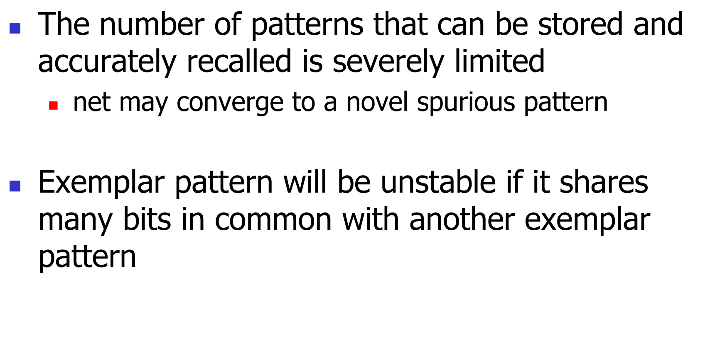
Review:Hopfield network

Slide 55



THANK YOU
Visit us
FOLLOW us
www.xjtlu.edu.cn
@xjtlu
Notes:
Title: Uppercase, Calibri size 60, XJTLU Navy

